Slide 1
A Randomized, Double-blind, Placebo-controlled Trial of Intravenous Erythropoietin in Patients with ST-Segment Elevation Myocardial Infarction – Primary Results of the REVEAL Trial

Slide 2
STEMI n=110
Primary or rescue PCI
TIMI 0-1 flow in IRA
Successful PCI
- Randomize
- Study drug within 4 hrs
IV EPO
Matching saline
placebo
Infarct size in IRA territory 2-6 days by cMRI

Slide 3
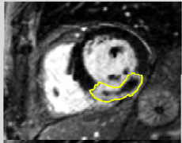
Results: Primary endpoint Mean (SE) infarct size at 2-6 days after study drug admin
25
EPO
Placebo
20
EPO vs. placebo
15.8% vs. 15.0%, P=NS
P-value adjusted for age, infarct location,
enrollment phase
15
Infarct Size (%LV)
10
5
0

Slide 4
Conclusions
These data, coupled with the lack of efficacy seen in other STEMI trials involving EPO (REVIVAL-3¹, HEBE III²), do not support the hypothesis that EPO favorably impacts outcome after reperfusion for STEMI
Whether earlier administration or alternate dosing provides a cardioprotective effect of EPO in humans remains to be determined
¹Ott I, et. al. Circ:CV Intv 2010
²Voors AA, et. al. EHJ 2010

