Slide 1
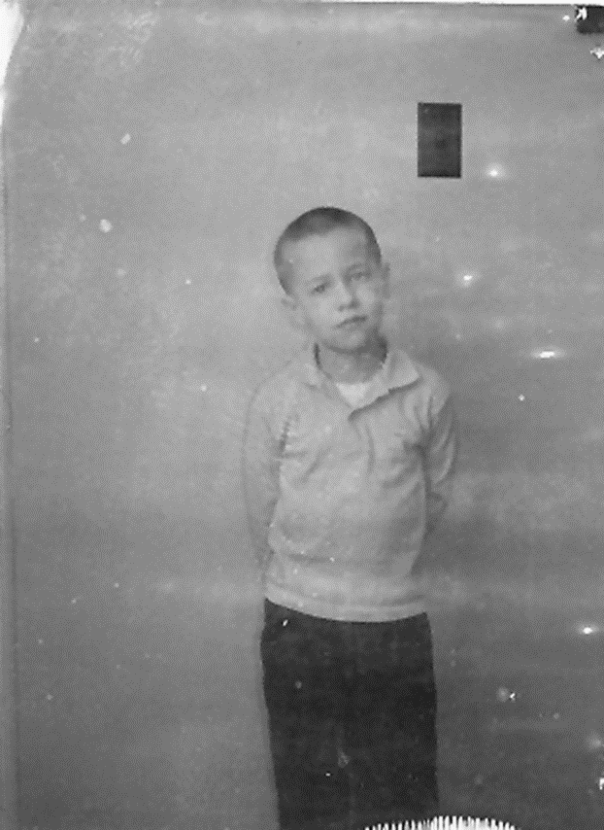
Stilwell Oklahoma, 1967
Copyleft by CM Gibson

Slide 2
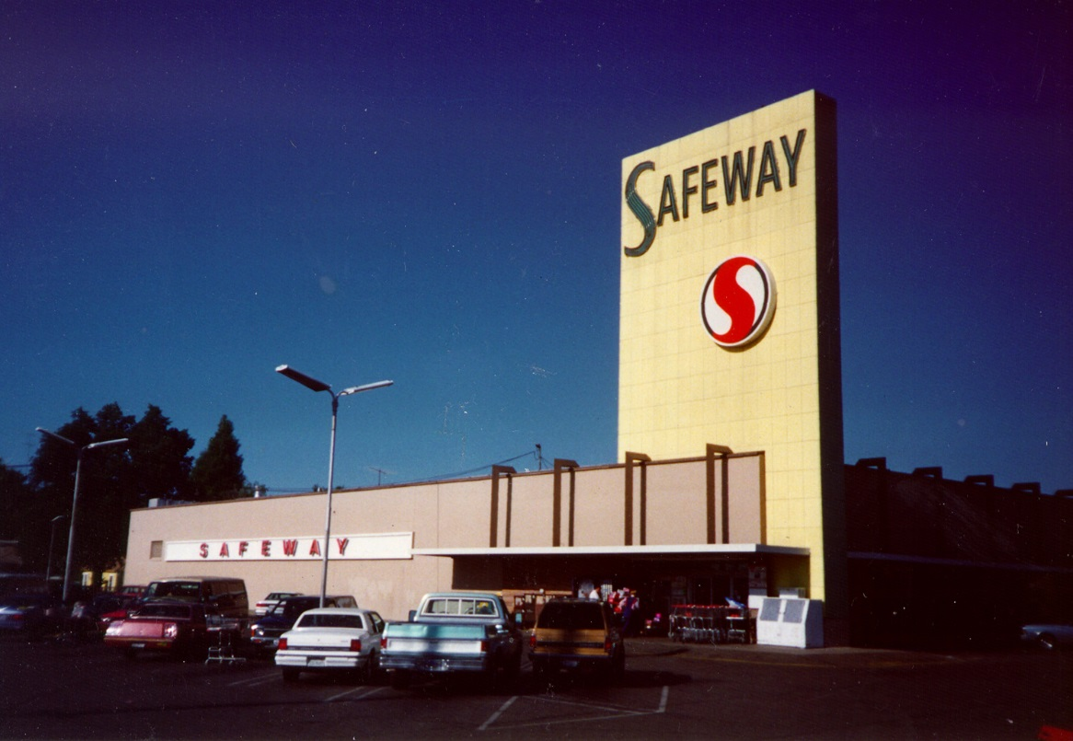
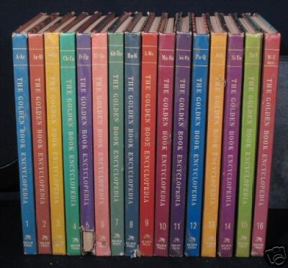
Stilwell Oklahoma 1968
Copyleft by CM Gibson

Slide 3
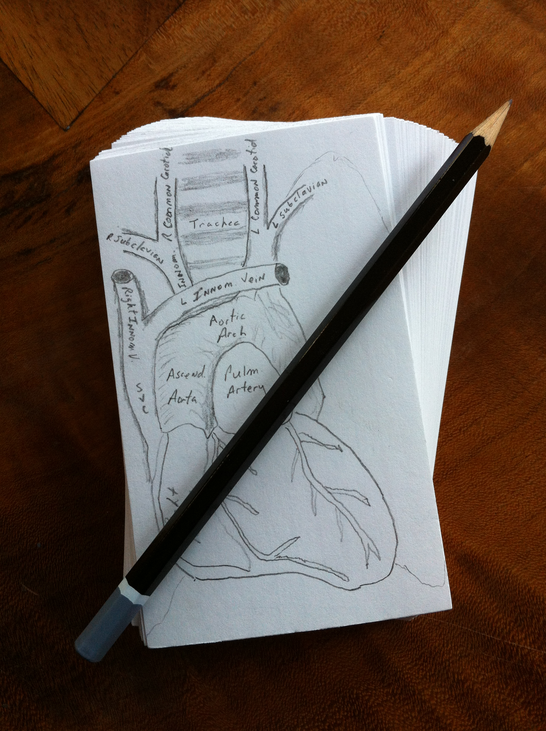
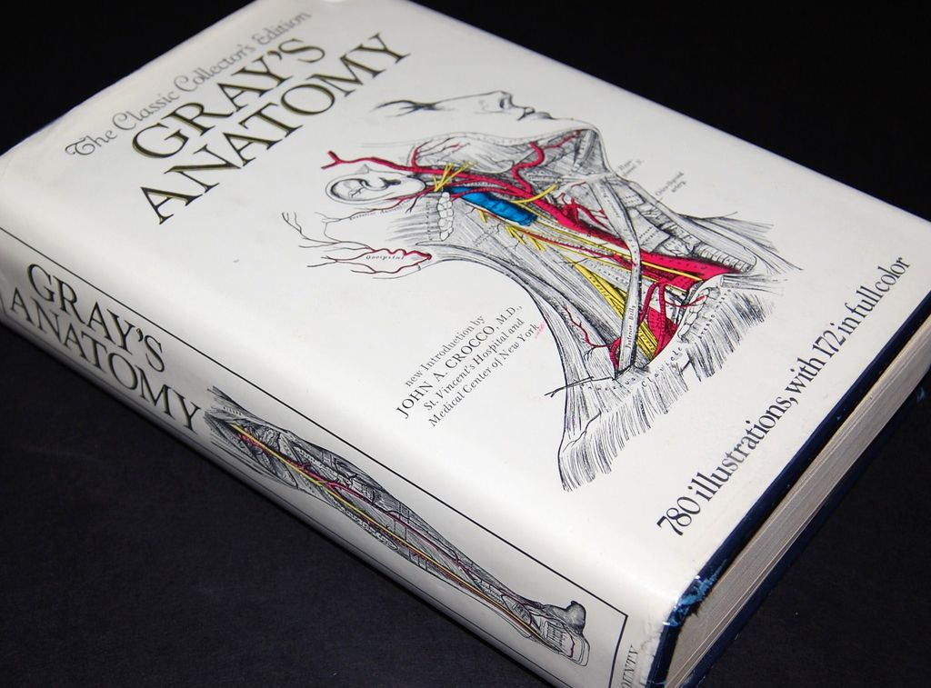
Medical School 1982
Copyleft by CM Gibson

Slide 4
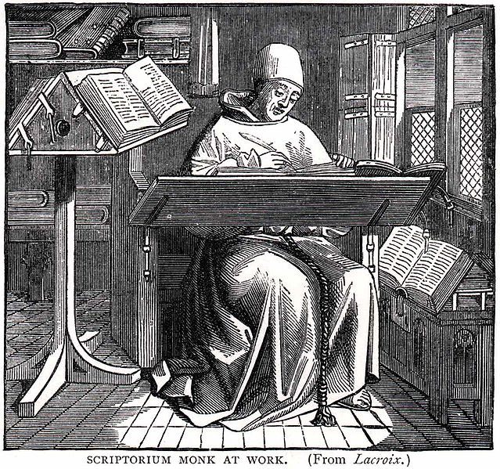
The Monk
Copyleft by CM Gibson

Slide 5
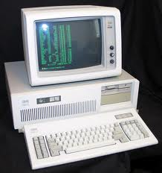
Boston 1986
Copyleft by CM Gibson

Slide 6
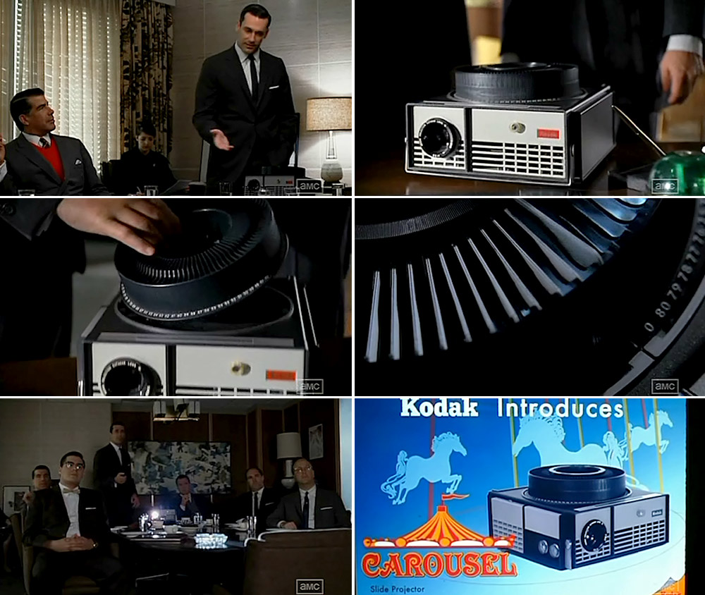
Definition of an Expert:
A Guy With Two Slide Carousels From Boston
“It goes backwards, and forwards... it takes us to a place where we ache to go again. It's not called the wheel, it's called the carousel.” Don Draper, Mad Men

Slide 7
The Perfect Storm
“You can’t take data from tables, make a bar graph and display it on a slide. (Famous Journal) owns not only the data, but also the mode of display of the data. The data must be displayed as it was published”
A major cardiovascular society threatened to sue me for copyright infringement for making up slides from a publication that I was involved in.
Research fellow: I can’t afford the $450 to download the pdfs of our publications.
Copyleft by CM Gibson

Slide 8
The Monk
Copyleft by CM Gibson

Slide 9
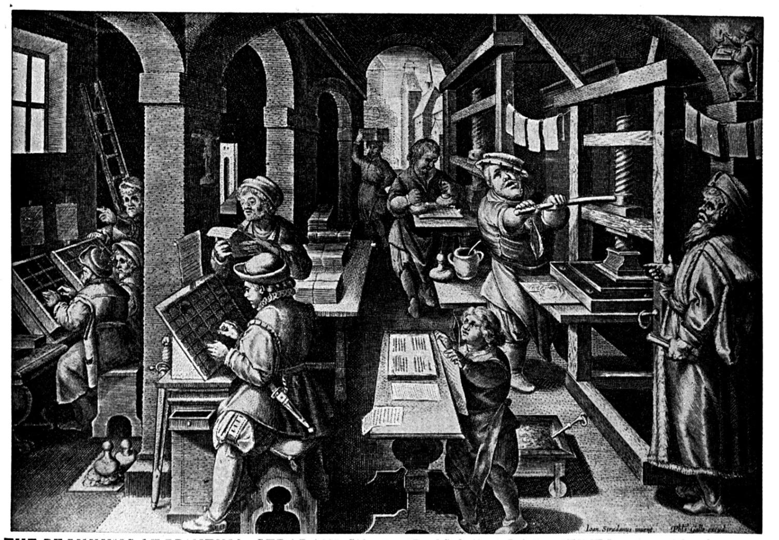
The Printing Press
For the first time, the printing press allowed rapid distribution of large volumes of printed work, some of which could be critical of English government
Copyright originated out of English government’s need to control and censor the new flood of seditious printed matter
Government permitted only certain people the “Right to Copy” work, the original copyright law was actually a censorship law
Copyleft by CM Gibson

Slide 10
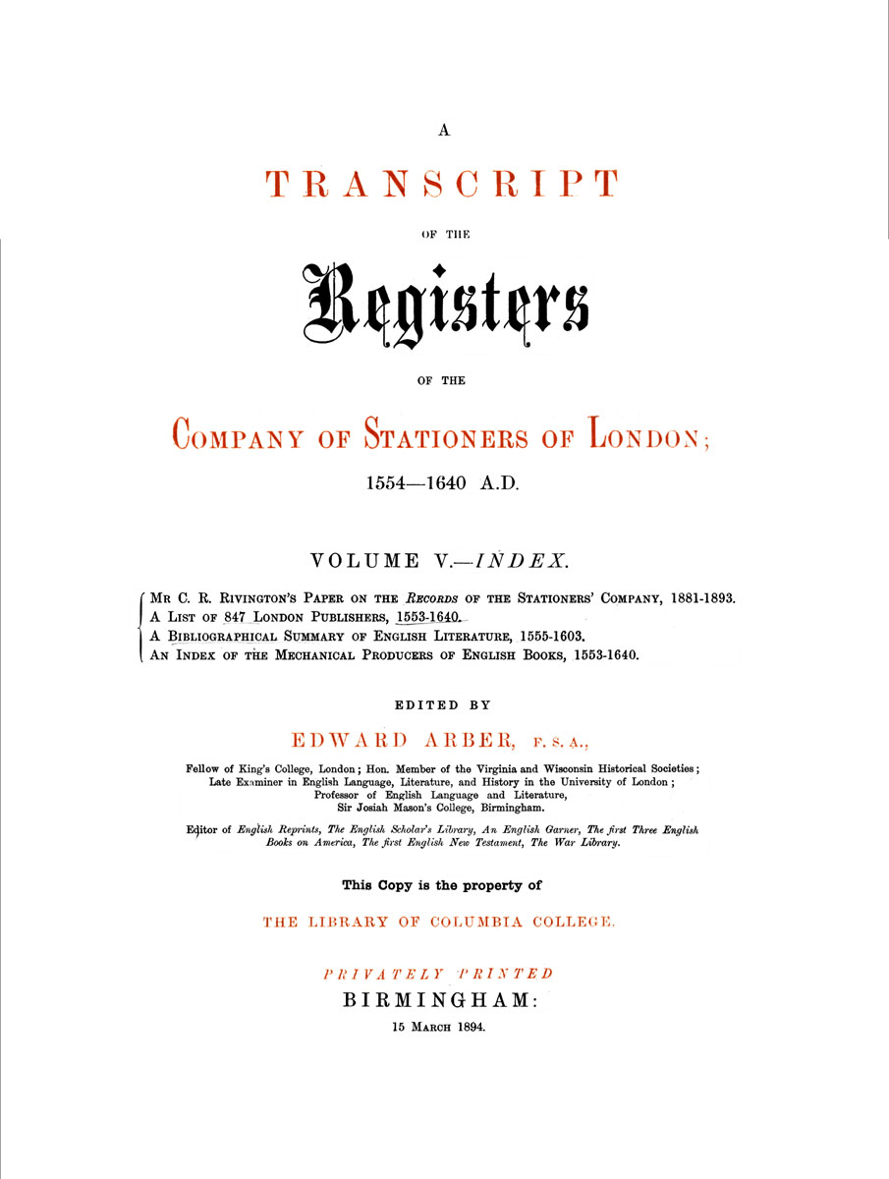
Early Copyright Law: London Company of Stationers
Government allowed a private company (the London Company of Stationers) to oversee censorship. Company had
Exclusive right to print
Right to confiscate unauthorized presses and books
Right to burn illegally printed books
Only books that had passed the “Crown’s censor” were entered in the company's Register
Books were entered into the Registry under a publishing company’s name, not the author’s name
The company who registered the book held the “copyright” which provided exclusive rights to publish the book over other companies
Early copyright law was clearly designed to protect the government (establish control) and the publishing companies (establish ownership), not the authors or creators of work
Copyleft by CM Gibson

Slide 11
Statute of Anne: 1709
Parliament sought to relax censorship by the King at end of 17th century, & allowed Stationers' monopoly to expire
Stationers shrewdly argued that copyright should originate with authors to avoid claims against king for censorship
But, this was a Pyrrhic victory as the authors had no choice but to sign their copyright over to a publisher (who over a century had established ownership and control of printing presses, typesetting and transportation networks) if they wanted their work distributed
Early copyright law was lobbied for by distributors, to protect economic interests of distributors not the creators of content
Copyleft by CM Gibson

Slide 12
Medical Textbooks
Paper format
May be outdated before it is printed
Represents views of selected authors
Broad community peer review lacking
Text based: No video, no audio, non-interactive, one way flow of information
Copyrighted, access limited to those who can afford it
Copyleft by CM Gibson

Slide 13
General Practitioner and Specialist’s Income
Country | GDP per capita USD ($) | Population (million) | GP's Monthly Salary (USD $) | Specialist's Monthly Salary (USD $)
Tajikistan | 1,300 | 7.1 | 35 | 50
India | 3,800 | 1128.2 | 637 | 1274
Azerbaijan | 7,500 | 8.5 | 130 | 155
China | 7,800 | 1323.6 | 133 - 160 | 170 - 230
Russia | 12,200 | 142.3 | 210 | 290 - 320
Poland | 14,400 | 38.2 | 580 | 750
United States | 43,800 | 301.1
Fact Book 2008

Slide 14
Whose Rights Should be Protected in the Modern Electronic Era?
Early copyright law protected economic interests of publishers who had invested in infrastructure to print and distribute work
But in contrast to the printed world, in the modern electronic world, the cost of creating content & distributing it over the internet is negligible
Should access to life saving medical information be a right or should access remain a privilege behind paywalls?
Whose rights should take precedence? Consumer, Creator, or Conveyor of the information?
Copyleft by CM Gibson

Slide 15
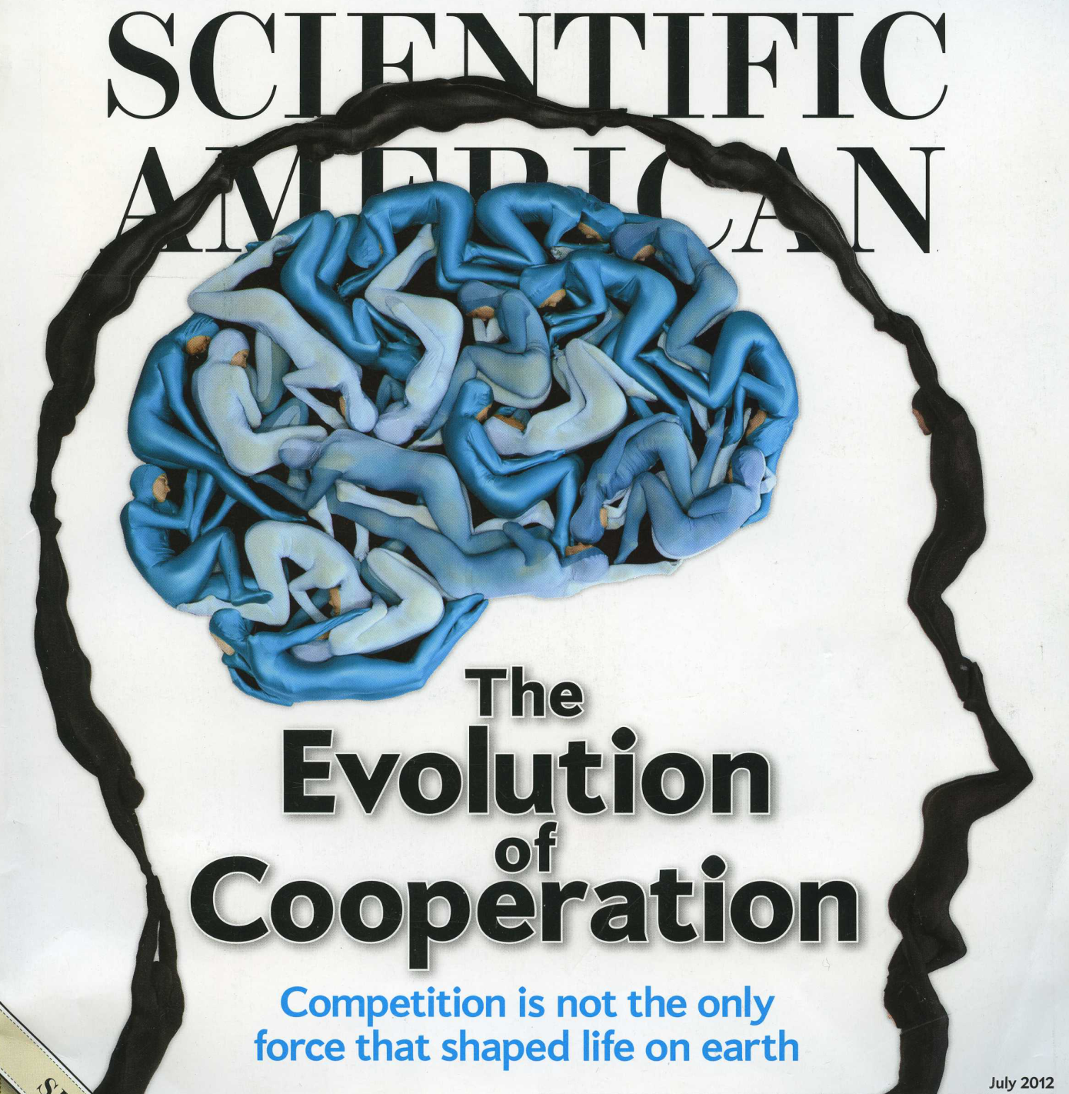
Copyleft by CM Gibson

Slide 16
Old World vs New World: Competition vs Collaboration
Old World
New World
Expensive Weapons of Mass Destruction
Inexpensive Weapons of Mass Collaboration
Copyleft by CM Gibson

Slide 17
Old World vs New World: Internet
Old World
New World
Internet 1.0
Website with one directional
flow of information
Internet 2.0
Participatory community with bidirectional flow of information
Think Twitter, YouTube; Facebook; Wikipedia
Copyleft by CM Gibson

Slide 18
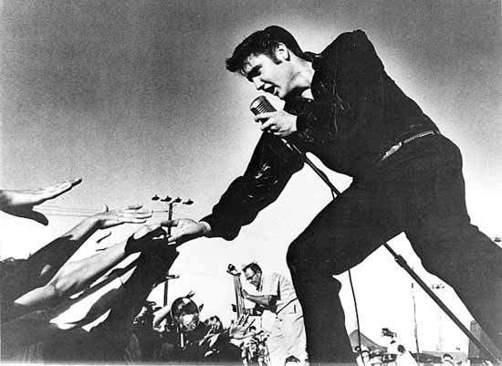
Old World vs New World: Reach and Content
Broadcast one show to millions
Broadcast millions of shows to one
Copyleft by CM Gibson

Slide 19
Old World vs New World: Organizational Structure
Old World
New World
Symbol: The Silo
Organization: Vertical
“Command and
Control”
The corner office
Symbol: The Globe
Organization: Horizontal
“Co-creation” “Collective genius”
“Peering” “Online collectivism”
Open space no walls
Copyleft by CM Gibson

Slide 20
Old World vs New World: Medicine & Collaboration
Old World
New World
John is the brightest child in kindergarten
Physician as “individual player”
Promotion depends on first/last author publications
Publish or perish
John plays well with others in kindergarten
Physician as “team player”
Promotion depends upon more broadly conceived contributions and collaboration
Collaborate or perish
Copyleft by CM Gibson

Slide 21
Old World vs New World: Evidence Based Replaces Eminence Based As The Truth Standard
Old World
New World
The professor
Eminence based therapy:
“In my experience …”
Consensus & guidelines
Evidence based therapy:
“In the randomized trial …”
Copyleft by CM Gibson

Slide 22
Physician / Patient Power Gradient
Old World
New World
Trusted provider conveys paternalistic, proscriptive information in 1 way conversation to uninformed patient
Guidelines based medicine (one size fits all)
We must earn the trust of knowledgeable patients through 2 way conversation
Personalized medicine (tailored to genetics, risk factors)
Copyleft by CM Gibson

Slide 23
Old World vs New World: Information Flow
Old World
New World
Insular and Secretive
Innovate from within
Knowledge flowed only to
those at the top
Medium: Paper
Copyright
Open Source
Innovate from without
Knowledge flows to and
from all
Medium: Internet
Copyleft
Copyleft by CM Gibson

Slide 24
What is Copyleft?
Copyleft is a legal principle which safeguards against information being controlled by any one person, and ensures that it remains freely accessible forever.
All of the information in a copyleft document is free for anyone to copy, modify for their own purposes, and redistribute or use as they see fit, as long as the new version grants the same freedoms to others and acknowledges the authors of the original article (a credit or backlink to the original article is sufficient for this).
Copyleft by CM Gibson

Slide 25
What is a Wiki?
A Wiki is an open source computer program that allows multiple authors to co-create a webpage.
The authors do not need to know how to program in HTML.
Copyleft by CM Gibson

Slide 26
MediaWiki: The Wiki Software
What if someone makes a mistake or vandalizes the site?
A Wiki is a database, and any page can be restored to an older version.
Can there be a discussion about the content?
Yes. Click on the Discussion tab and there is a forum.
How do you know when a change has been made to a page?
You can receive an email notifying you a change was made.
Copyleft by CM Gibson

Slide 27
Wiki’s May Be Less Biased
Because articles are written based upon consensus, a Wiki is less susceptible to retaining bias, a Wiki is very hard for any group to censor, and a Wiki may be more rapidly responsive to new information.
Copyleft by CM Gibson

Slide 28
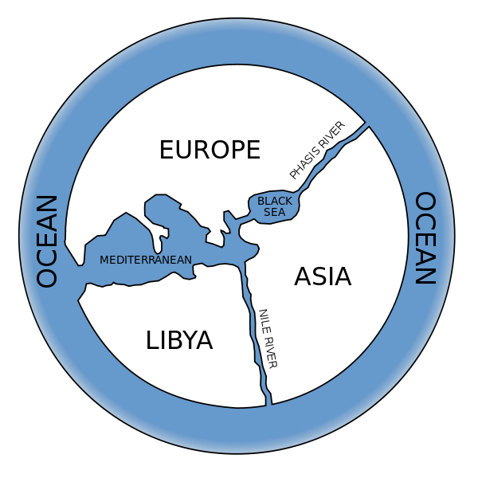
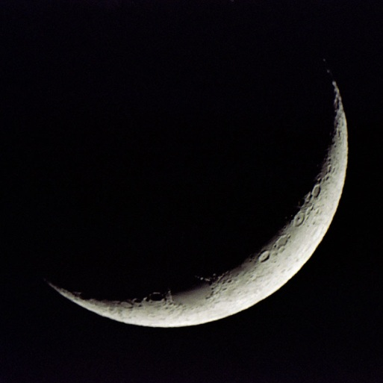
The “World May Be Flat”, But “The Earth is Round”
One of the tenets of Friedman's "The World is Flat" is that Innovation increases as open access to information increases.
Although the “Wisdom of the Crowd” argued literally that the "World is Flat" several centuries ago, a select number of “Experts" demonstrated the world is in fact round.
The World is Flat:
Wisdom of the Crowd
The Earth is Spherical:
Expert Opinion
Copyleft by CM Gibson

Slide 29
Are Wikis Accurate?
In order to test its reliability, Nature conducted a peer review of scientific entries on Wikipedia and the well-established Encyclopedia Britannica.
Reviewers were blinded to the source of information and were asked to check for errors in 50 articles matched for length.
Reviewers were asked to look for three types of inaccuracy: factual errors, critical omissions and misleading statements
"Only eight serious errors, such as misinterpretations of important concepts, were detected in the pairs of articles reviewed, four from each encyclopedia," reported Nature.
Nature 438, 900-901; 2005
Copyleft by CM Gibson

Slide 30
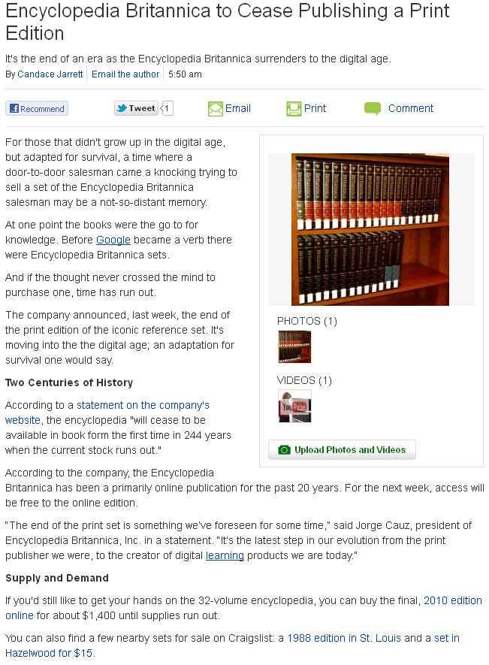
Encyclopedia Britannica Ceases in Book Form after 244 Years
Copyleft by CM Gibson

Slide 31
The Ideal “Textbook”
Free, no pharmaceutical or device company support, viewer supported
Mission statement: “Healthcare is enriched when medical knowledge flows freely.”
Continuously updated leverage power of social media, moderated crowdsourcing by experts
Copyleft safeguards against information being controlled by any one person, and ensures that it remains freely accessible forever; all of the information is free for anyone to copy, modify for their own purposes, and redistribute or use as they see fit, as long as the new version grants the same freedoms to others and acknowledges the authors of the original article
Copyleft by CM Gibson

Slide 32
The Ideal “Textbook”
Accessible on mobile devices, which many MDs in developing countries have
Doctor and patient content linked (57% of patients use internet for medical information)
CME and board review doctors earn CME credit “on the fly” or “micro CME” for looking up medical information
Living guidelines with polling, potential to suggest edits to guidelines
Multimedia videos, sounds, slides
Multilingual
Copyleft by CM Gibson

Slide 33
WikiDoc & WikiPatient: Overview
Creator: C. Michael Gibson, M.S., M.D. in late 2005
Authors: 7,269
Chapters: 115,348
Edits: 859,941
“Copyleft” images uploaded: 31,671
Full time volunteer staff on site in Boston: 25-30
Copyleft by CM Gibson

Slide 34
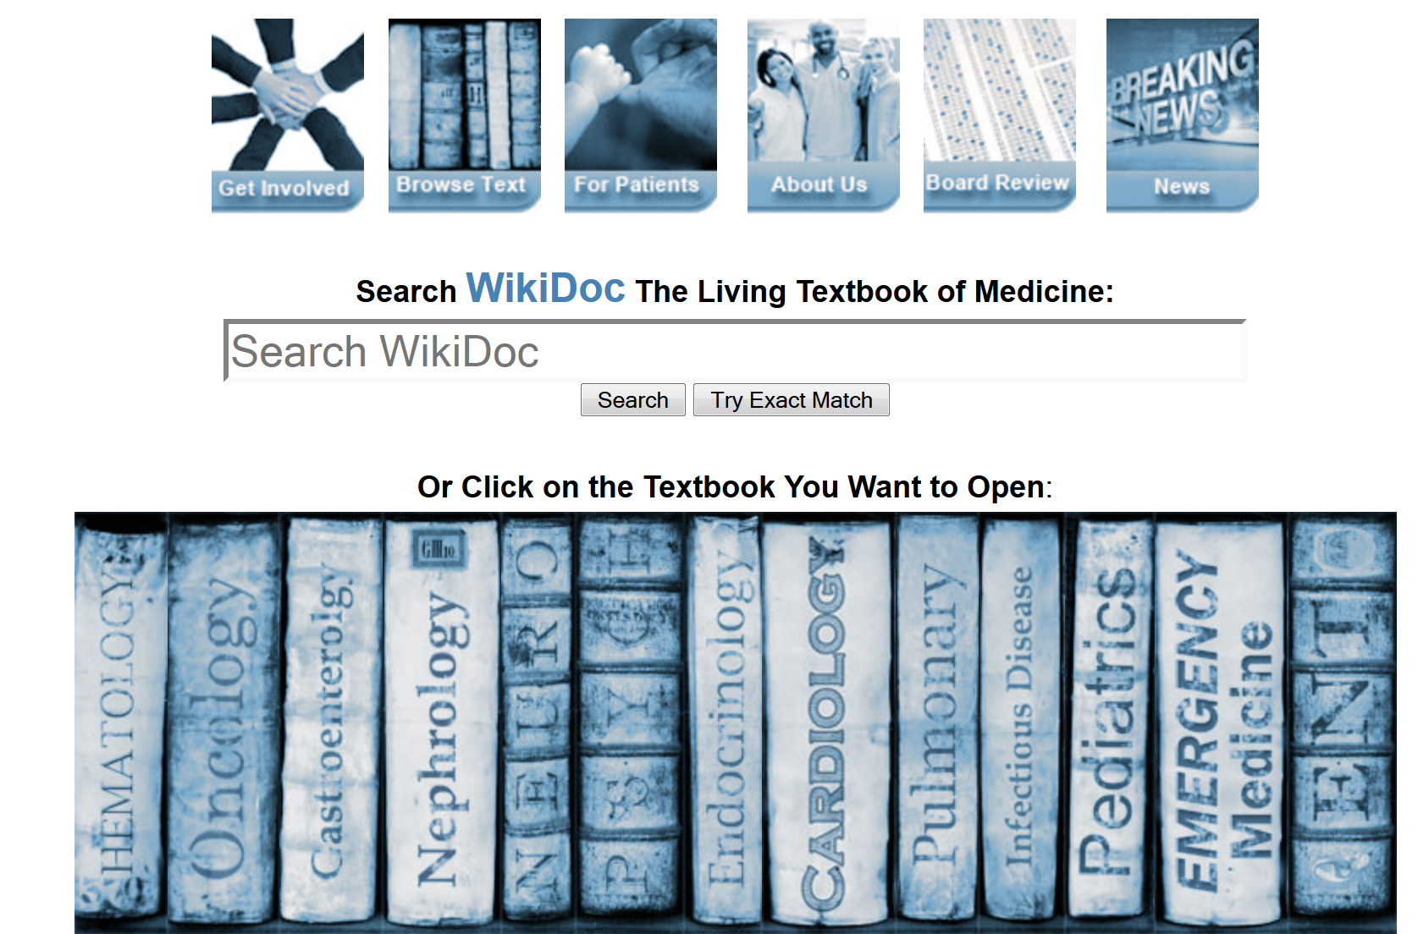
Copyleft by CM Gibson

Slide 35
Who Can Get Involved?
Anybody! You do not need to be a doctor
Students
Nurses
Research assistants
Physician assistants
Technicians
Administrators
Laypeople
Copyleft by CM Gibson

Slide 36
Pre-Medical Students: WikiDoc Scholars Program
Editing grammar & improving functionality (cleaning pages and fixing links)
Improving WikiPatient pages
Adding pictures of pills to the Pill Identifier Database
Integrating content from the FDA drug label
Teaching others how to edit pages
Translating content in other languages
Adding MCAT questions to the board review section
Building the differential diagnosis database
Adding copyleft pictures and images
Copyleft by CM Gibson

Slide 37
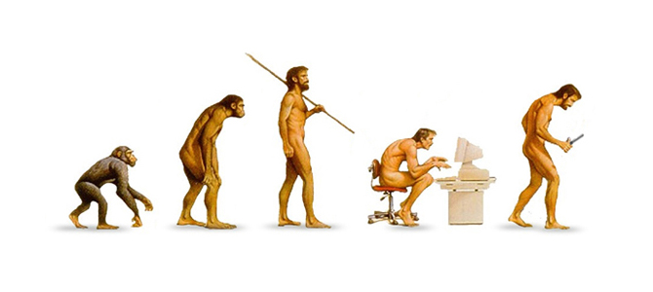
Evolution of Medical Information
Oral
Tradition
Paper
Textbooks & Articles Behind Paywalls
PC
Web 1.0
One way conveyance of data behind paywalls
Mobile
Web 2.0
Free
WikiDoc
Copyleft by CM Gibson

