Slide 1
hsCRP, Inflammation, LDL, and The JUPITER Trial: Rationale, Results, and Public Health Implications
Paul M Ridker, MD, MPH
Eugene Braunwald Professor of Medicine
Director, Center for Cardiovascular Disease Prevention
Brigham and Women’s Hospital
Harvard Medical School, Boston, MA USA
Dr Ridker is listed as a co-inventor on patents held by the Brigham and Women’s Hospital
that relate to the use of inflammatory biomarkers in cardiovascular disease and diabetes.

Slide 2
Dr Ridker has received investigator-initiated research support from the NHLBI, NCI, American Heart Association, Donald W Reynolds Foundation, Leduc Foundation, Doris Duke Charitable Foundation, AstraZeneca, Novartis, and SanofiAventis.
Dr Ridker has served as a consultant to Seimens, AstraZeneca, Vascular Biogenics, Merck Schering Plough, and Novartis.
Dr Ridker is listed as a co-inventor on patents held by the Brigham and Women’s Hospital that relate to the use of inflammatory biomarkers in cardiovascular disease and diabetes that have been licensed to Seimens and AstraZeneca.

Slide 3
LDLC Levels in 136,905 Patients Hospitalized With CAD: 2000- 2006
LDLC (mg/dL)
< 130
130-160
> 160
Sachdeva et al, Am Heart J 2009;157:111-7.e2.

Slide 4
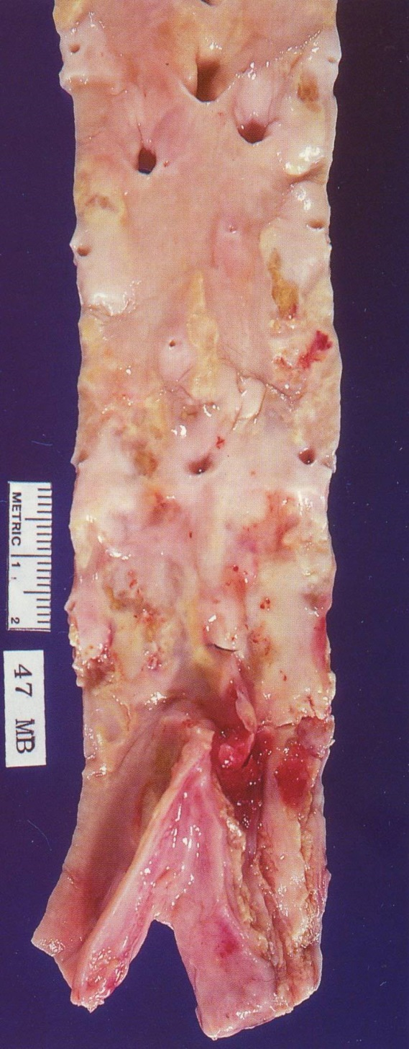
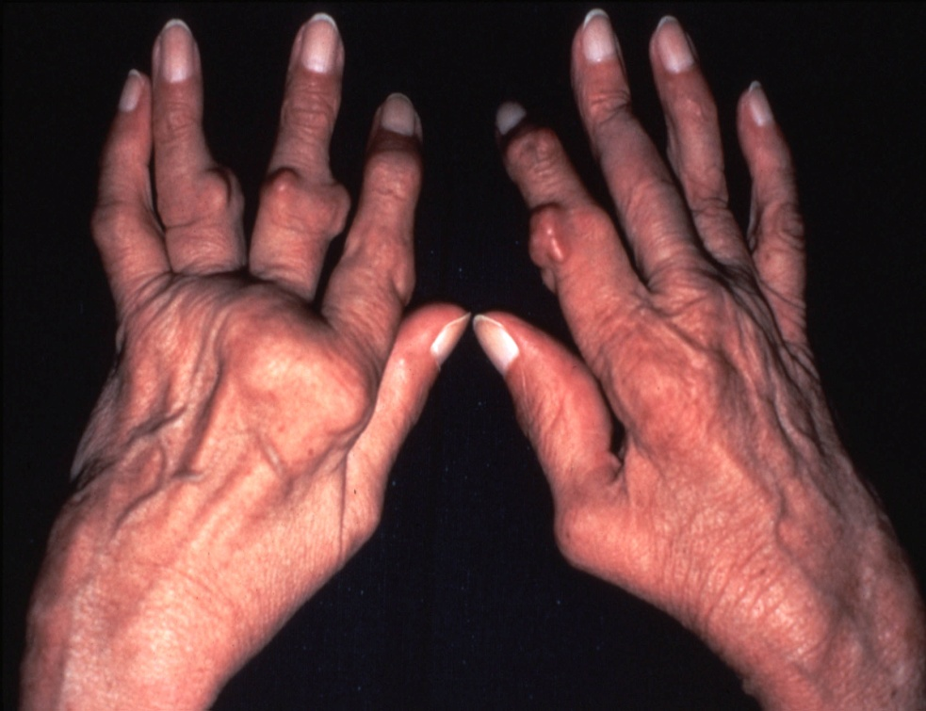
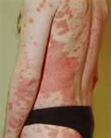

Slide 5
hsCRP and Risk of Future MI and CVA in Apparently Healthy Men
P Trend <0.001
P Trend <0.01
3
2
2
Relative Risk of MI
Relative Risk of Stroke
1
1
0
0
1
2
3
4
1
2
3
4
Quartile of hs-CRP
Quartile of hs-CRP
Ridker et al, N Engl J Med 1997;336:973–979.

Slide 6
hsCRP Adds Prognostic Information Beyond Traditional Risk Factors in All Major Cohorts Evaluated
PHS 1997
WHS 2000
UK 2000
MONICA 2004
ARIC 2004
Iceland 2004
NHS 2004
Fully Adjusted Relative Risk
HPFUS 2004
EPIC-N 2005
Strong 2005
Kuopio 2005
CHS 2005
PIMA 2005
FHS 2008
Ridker P. JACC 2007; 49: 2129-2138
< 1 mg/L
1 to 3 mg/L
> 3 mg/L

Slide 7
C-reactive protein concentration and risk of cardiovascular events : 2010
Coronary Heart Disease
3.0
2.5
2.0
1.5
1.0
Ischaemic Stroke
3.0
2.5
2.0
Risk ratio (95% CI)
1.5
1.0
All Vascular Deaths
3.0
2.5
2.0
1.5
1.0
0.5
1.0
2.0
4.0
8.0
0.5
1.0
2.0
4.0
8.0
hsCRP concentration (mg/L)
Age, gender adjusted
Fully adjusted
Emerging Risk Factor Collaborators, Lancet Jan 2010

Slide 8
Direct comparison of hsCRP, systolic blood pressure, total cholesterol, and non-HDLC
C-reactive protein concentration and risk of cardiovascular events : 2010
Risk Ratio (95%CI)
hsCRP
Systolic BP
Total cholesterol
Non-HDLC
1.37 (1.27-1.48)
1.35 (1.25-1.45)
1.16 (1.06-1.28)
1.28 (1.16-1.40)
0.5 1.0 1.2 1.4 1.8
Risk Ratio (95%CI) per 1-SD higher usual values
Adjusted for age, gender, smoking, diabetes, BMI, BP, triglycerides, alcohol, lipid levels, and hsCRP
Emerging Risk Factor Collaborators, Lancet Jan 2010

Slide 9
Inflammation, hsCRP, and Vascular Prevention
FDA Perspective
Is there evidence that individuals with elevated levels of the inflammatory biomarker hsCRP are at increased vascular risk?
Is there evidence that individuals identified at increased risk due to inflammation benefit from a therapy they otherwise would not have received?

Slide 10
Inflammation, Statin Therapy, and hsCRP: Initial Observations
P Trend = 0.005
-21.6% (P=0.004)
3
0.25
0.24
Placebo
2
0.23
Relative Risk
0.22
Median hs-CRP (mg/dL)
0.21
1
Pravastatin
0.20
0.19
0
0.18
Pravastatin
Placebo
Pravastatin
Placebo
Baseline
5 Years
Inflammation Absent
Inflammation Present
Ridker et al, Circulation. 1998;98:839–844.
Ridker et al, Circulation. 1999;100:230-235.

Slide 11
Primary Prevention : Whom Should We Treat ?
1.00
hsCRP < 2, LDL < 130
0.99
hsCRP < 2, LDL > 130
0.98
Probability of Event-free Survival
hsCRP > 2, LDL < 130
0.97
0.96
hsCRP > 2, LDL > 130
0.00
0
2
4
6
8
Years of Follow-up
Ridker et al, N Engl J Med. 2002;347:1557-1565.

Slide 12
hsCRP as a Method to Target Statin Therapy in Primary Prevention: AFCAPS/TexCAPS
Study Group Statin Placebo NNT
low LDLC / low hsCRP 0.025 0.022 ----
low LDLC / high hsCRP 0.029 0.051 48
high LDLC / low hsCRP 0.020 0.050 33
high LDLC / high hsCRP 0.038 0.055 58
Median LDLC = 150 mg/dL
Median CRP = 2 mg/L
Ridker et al, N Engl J Med 2001;344:1959-65

Slide 13
“These hypothesis generating clinical studies, together with the recognition that… atherosclerosis is in part an inflammatory disease and that the lowering of lipid levels may represent an anti-inflammatory process, appear to provide a rationale for considering wider use of statins than is typically achieved in current practice”.
“Nonetheless, despite large differences in the number needed to treat… the absolute number of events that occurred in each of the four [AFCAPS/TexCAPS] subgroups was small… Thus, randomized trials of statin therapy among persons without overt hyperlipidemia but with evidence of systemic inflammation are needed in order to test these hypotheses directly.”
Ridker et al, N Engl J Med 2001;344:1959-65

Slide 14
JUPITER: Trial design
Multi-National Randomized Double Blind Placebo Controlled Trial of Rosuvastatin in the Prevention of Cardiovascular Events Among Individuals With Low LDL and Elevated hsCRP
MI
Stroke
Unstable
Angina
CVD Death
CABG/PTCA
No Prior CVD or DM
Men ≥50, Women ≥60
LDL <130 mg/dL
hsCRP ≥2 mg/L
Rosuvastatin 20 mg (N=8901)
4-week run-in
Placebo (N=8901)
Argentina, Belgium, Brazil, Bulgaria, Canada, Chile, Colombia, Costa Rica,
Denmark, El Salvador, Estonia, Germany, Israel, Mexico, Netherlands,
Norway, Panama, Poland, Romania, Russia, South Africa, Switzerland,
United Kingdom, Uruguay, United States, Venezuela

Slide 15
JUPITER: Primary Objectives
To investigate whether rosuvastatin 20 mg compared to placebo would decrease the rate of first major cardiovascular events among apparently healthy men and women with LDL < 130 mg/dL (3.36 mmol/L) who are nonetheless at increased vascular risk on the basis of an enhanced inflammatory response, as determined by hsCRP ≥ 2 mg/L.
To enroll large numbers of women and individuals of Black or Hispanic ethnicity, groups for whom little data on primary prevention with statin therapy exists.
Justification for the Use of statins in Prevention:
an Intervention Trial Evaluating Rosuvastatin

Slide 16
JUPITER: Why Consider Statins for Low LDL, high hsCRP Patients?
AFCAPS/TexCAPS Low LDL Subgroups
Low LDL, Low hsCRP
Low LDL, High hsCRP
0.5
1.0
2.0
RR
Statin Effective
Statin Not Effective
While intriguing and of potential public health importance, the observation in AFCAPS/TexCAPS that statin therapy might be effective among those with elevated hsCRP but low cholesterol was made on a post hoc basis. Thus, a large-scale randomized trial of statin therapy was needed to directly test this hypotheses.
Ridker et al New Engl J Med 2001;344:1959-65.

Slide 17
JUPITER: Trial Structure
Independent Steering Committee:
P Ridker (Chair), F Fonseca, J Genest, A Gotto, J Kastelein, W Koenig, P Libby, A Lorenzatti, B Nordestgaard, J Shepherd, J Willerson
Independent Academic Clinical Coordinating Center:
P Ridker, E Danielson, R Glynn, J MacFadyen, S Mora (Boston)
Independent Academic Study Statistician:
R Glynn (Boston)
Independent Data Monitoring Board:
R Collins (Chair), K Bailey, B Gersh, G Lamas, S Smith, D Vaughan
Independent Academic Clinical Endpoint Committee:
K Mahaffey (Chair), P Brown,D Montgomery, M Wilson, F Wood (Durham)
NEJM 2008; 359: 2195-2207

Slide 18
JUPITER: 17,802 Patients, 1,315 Sites, 26 Countries
25
Total Randomized = 17,802
4021
20
2873
15
2497
Randomizations (% Total.)
2020
10
804
987
5
741
336
345
487
197
202
204
209
222
253
270
273
327
14
15
32
83
85
143
162
0
Chile
Poland
Canada
Uruguay
Estonia
Israel
Panama
Russia
Mexico
Romania
Bulgaria
El Salvador
Norway
Costa Rica
Belgium
Germany
Colombia
Denmark
Switzerland
Venezuela
Argentina
Brazil
South Africa
United States
The Netherlands
United Kingdom
Notes:
18
Am J Cardiol 2007; 100:1695-1664

Slide 19
JUPITER: Inclusion/Exclusion Criteria, Study Flow
89,890 screened
Reason for Exclusion %
LDL>130 mg/dL 52
hsCRP<2 mg/L 36
Withdrew consent 5
Diabetes 1
Hypothyroid <1
Liver disease <1
TG >600 mg/dL <1
Age out of range <1
Current use of HRT <1
Cancer <1
Poor compliance/Other <1
Inclusion criteria
Men >50 years
Women >60 years
No CVD, No DM
LDL <130 mg/dL
hsCRP >2 mg/dL
4 week
Placebo
Run-in
17,802 Randomized
8901 assigned to Rosuvastatin 20 mg
8901 assigned to Placebo
8,169 fully complete
8,857 Vital status known
19 % d/c study med
7.8 % withdrew
2.0 % non-trial statin
8,155 fully complete
8,864 Vital status known
22 % d/c study med
8.0 % withdrew
4.4 % non-trial statin
8,901 Included in Efficacy
and Safety Analyses
8,901 Included in Efficacy
and Safety Analyses

Slide 20
JUPITER: Pre-specified Monitoring and Stopping Guidelines
JUPITER was an event-driven trial designed to continue until accrual of 520 confirmed primary endpoints to attain 90% power to detect a 25% reduction in the rate of the primary endpoint
The monitoring plan specified interim efficacy analyses with O’Brien-Fleming stopping boundaries determined by the Lan-DeMets approach upon attainment of 37.5% and 75% of the targeted numbers of endpoints
The IDMB charter specified that an early stopping recommendation required proof beyond reasonable doubt that for all, or some specific types of patients, prolonged use of rosuvastatin is clearly indicated or clearly contraindicated based on the interim analyses or other sources which might reasonably be expected to influence clinicians’ management decisions for subjects in the study

Slide 21
JUPITER: Statistical Analysis Plan
Primary efficacy analyses counted all events diagnosed by March 30, 2008 according to the intention to treat principle. Safety analyses included events through the closeout visit, with the last closeout visit on August 20, 2008
Statistical significance determined by a likelihood ratio test of a proportional hazards model including only the treatment assignment. Validity of the proportional hazards assumption was evaluated graphically and by a likelihood ratio test of interaction between treatment effect and study time
Possible heterogeneity in the relative treatment effect across subgroups evaluated through likelihood ratio tests of interaction terms in a proportional hazards model
Estimates of net clinical benefits were based on the number needed to treat (NNT) over 4 years and projected to 5 years by the method of Altman and Andersen

Slide 22
JUPITER: Baseline Blood Levels (Median, Interquartile Range)
 | Rosuvastatin (N=8901) | Placebo (n=8901)
hsCRP mg/L | 4.2 (2.8 – 7.1) | 4.3 (2.8 – 7.2)
LDL mg/dL mmol/L | 108 (94 – 119) 2.8 (2.43 – 3.08) | 108 (94 – 119) 2.8 (2.43 – 3.08)
HDL mg/dL mmol/L | 49 (40 – 60) 1.27 (1.03 – 1.55) | 49 (40 – 60) 1.27 (1.03 – 1.55)
Triglycerides mg/dL mmol/L | 118 (85 – 169) 1.33 (0.96 –1.91) | 118 (86 – 169) 1.33 (0.97 – 1.91)
Total Cholesterol mg/dL mmol/L | 186 (168 – 200) 4.82 (4.35 – 5.18) | 185 (169 – 199) 4.79 (4.38 – 5.15)
Glucose mg/dL mmol/L | 94 (87 – 102) 5.22 (4.83 – 5.66) | 94 (88 – 102) 5.22 (4.88 – 5.66)
Hb_{A1c} % | 5.7 (5.4 – 5.9) | 5.7 (5.5 – 5.9)
All values are median (interquartile range)
[Mean LDL = 104 mg/dL (2.69 mmol/L)]
Notes:
22
NEJM 2008;359:2195-2207

Slide 23
Comparison of the JUPITER Trial Population to Previous Statin Trials of Primary Prevention
 | JUPITER | WOSCOPS | AFCAPS
Sample size (n) | 17,802 | 6,595 | 6,605
Women (n) | 6,801 | 0 | 997
Non-Caucasian (n) | 5,118 | 0 | 350
Duration (yrs) | 1.9 (max 5) | 4.9 | 5.2
Diabetes (%) | 0 | 1 | 6
Baseline LDL-C (mg/dL) | 104 | 192 | 150
Baseline HDL-C (mg/dL) | 49 | 44 | 36-40
Baseline TG (mg/dL) | 118 | 164 | 158
Baseline hsCRP (mg/L) | >2 | NA | NA
Intervention | Rosuvastatin 20 mg | Pravastatin 40 mg | Lovastatin 10-40 mg
JUPITER Trial Study Group, Am J Cardiol 2007; 100: 1659-1664.

Slide 24
JUPITER: Primary Endpoint
9
Rosuvastatin
Placebo
8
Number of events 142 (1.6%) 252 (2.8%)
7
44%
6
HR 0.56 (95% CI 0.46-0.69) P=<0.00001
5
Cumulative incidence, %
4
3
2
1
0
0
1
2
3
4
Number at risk
Years
Rosuvastatin
8901
8412
3892
1352
543
156
Placebo
8901
8353
3872
1333
534
173

Slide 25
JUPITER: Primary Endpoint by Time Since Randomization
Time since randomization
P value
6 months
0.029
12 months
<0.001
18 months
<0.001
2 years
<0.001
2.5 years
<0.001
3 years
<0.001
0.1
1
Hazard ratio (95% CI)

Slide 26
JUPITER: Fatal or Nonfatal Myocardial Infarction
3
Rosuvastatin
Placebo
Number of events 31 68
2.5
2
HR 0.46 (95% CI 0.30-0.70)
P<0.0002
Cumulative Incidence
- 54 %
1.5
1
0.5
0
1
2
3
4
Follow-up Years

Slide 27
JUPITER: Fatal or Nonfatal Stroke
3
Rosuvastatin
Placebo
Number of events 33 64
2.5
2
HR 0.52 (95% CI 0.34-0.79) P=0.002
Cumulative Incidence, %
- 48 %
1.5
1
0.5
0
1
2
3
4
Follow-up Years
Notes:
NEJM 2008;359:2195-2207

Slide 28
JUPITER: Bypass Surgery or PTCA / Hospitalization for UA
Rosuvastatin
Placebo
6
Number of events 76 143
5
4
HR 0.53 (95% CI 0.40-0.70) P<0.00001
- 47 %
3
Cumulative Incidence, %
2
1
0
1
2
3
4
Follow-up Years
Number at Risk
Rosuvastatin
8,901
8,640
8,426
6,550
3,905
1,966
1,359
989
547
158
Placebo
8,901
8,641
8,390
6,542
3,895
1,977
1,346
963
538
176
Notes:
NEJM 2008;359:2195-2207

Slide 29
JUPITER: Primary Endpoint – Subgroup Analysis I
N
P for Interaction
Men
11,001
0.80
Women
6,801
Age ≤ 65
8,541
0.32
Age > 65
9,261
Smoker
2,820
0.63
Non-Smoker
14,975
Caucasian
12,683
0.57
Non-Caucasian
5,117
USA/Canada
6,041
0.51
Rest of World
11,761
Hypertension
10,208
0.53
No Hypertension
7,586
All Participants
17,802
0.25
0.5
1.0
2.0
4.0
Rosuvastatin Superior
Rosuvastatin Inferior
Notes:
NEJM 2008;359:2195-2207

Slide 30
JUPITER: Primary Endpoint – Subgroup Analysis II
N
P for Interaction
Family HX of CHD
2,045
0.07
No Family HX of CHD
15,684
BMI < 25 kg/m
²
4,073
0.70
BMI 25-29.9 kg/m
²
7,009
BMI ≥30 kg/m²
6,675
Metabolic Syndrome
7,375
0.14
No Metabolic Syndrome
10,296
Framingham Risk ≤ 10%
8,882
0.99
Framingham Risk > 10%
8,895
All Participants
17,802
0.25
0.5
1.0
2.0
4.0
Rosuvastatin Superior
Rosuvastatin Inferior
Notes:
NEJM 2008;359:2195-2207

Slide 31
JUPITER: Primary Endpoint By Ethnicity
Caucasian (N = 12,683)
Black, Hispanic, Other (N = 5,019)
HR 0.55 (95% CI 0.43-0.69)
P < 0.0001
HR 0.63 (95% CI 0.41-0.98)
P = 0.04
0.10
Placebo
0.08
Placebo
0.06
Cumulative Incidence
0.04
0.02
Rosuvastatin
Rosuvastatin
0.00
0
1
2
3
4
0
1
2
3
4
Follow-up (years)
Follow-up (years)

Slide 32
JUPITER: Death from Any Cause
7
Rosuvastatin
Placebo
6
Number of events 198 247
- 20 %
5
4
HR 0.80 (95% CI 0.67−0.97) P=0.021
Cumulative Incidence, %
3
2
1
0
0
1
2
3
4
6
Number at risk
Years
Rosuvastatin
8901
8787
4313
1601
682
Placebo
8901
8782
4323
1613
683
Notes:
Figure derived from Figure 11.2.1.18.3 of the Jupiter CSR in Module 5, Section 5.3.5.1.

Slide 33
JUPITER:
Individual components of the primary endpoint
Endpoint Rosuvastatin Placebo HR 95%CI P
Primary Endpoint* 142 252 0.56 0.46-0.69 <0.00001
Non-fatal MI 22 62 0.35 0.22-0.58 <0.00001
Any MI 31 68 0.46 0.30-0.70 <0.0002
Non-fatal Stroke 30 58 0.52 0.33-0.80 0.003
Any Stroke 33 64 0.52 0.34-0.79 0.002
Revascularization
or Unstable Angina 76 143 0.53 0.40-0.70 <0.00001
MI, Stroke, CV Death 83 158 0.52 0.40-0.68 <0.00001
Adjudicated CV Death 35 44 0.80 0.51-1.24 0.32
Total Mortality 198 247 0.80 0.67-0.97 0.02
*Nonfatal MI, nonfatal stroke, revascularization, unstable angina, CV death
NEJM 2008;359:2195-2207

Slide 34
JUPITER: US/Canada vs non-US/Canada
Region Rosuvastatin Placebo HR (95%CI) P value
Primary Endpoint
USA/Canada 81 (0.97) 136 (1.62) 0.60 (0.46-0.79) <0.001
Non-US/Canada 61 (0.60) 115 (1.14) 0.52 (0.38-0.71) <0.001
MI, CVA, CV Death
USA/Canada 40 (0.48) 75 (0.88) 0.54 (0.37-0.79) 0.001
Non-US/Canada 43 (0.42) 82 (0.81) 0.52 (0.36-0.75) <0.001
MI, CVA, Any Death
USA/Canada 100 (1.19) 148 (1.74) 0.68 (0.53-0.88) 0.003
Non-US/Canada 139 (1.36) 205 (2.03) 0.67 (0.54-0.83) <0.001

Slide 35
JUPITER: Venous Thromboembolism
Rosuvastatin
Placebo
Number of events 26 46
HR 0.57 (95% CI 0.35-0.91) P=0.018
- 43 %
Cumulative incidence, %
Number at Risk
Years
Rosuvastatin
8,901
8,648
8,447
6,575
3,927
1,986
1,376
1,003
548
161
Placebo
8,901
8,652
8,417
6,574
3,943
2,012
1,381
993
556
182
Clear clinical benefit for VTE/PE in the absence of any bleeding hazard
(hemorrhagic events : rosuvastatin 258, placebo 275, P=0.45)
Notes:
NEJM 2009;360:1851-1861

Slide 36
JUPITER: Conclusions – Primary Endpoint
Among apparently healthy men and women with elevated hsCRP but low LDL-C, rosuvastatin reduced major cardiovascular events by 44%
Benefits of rosuvastatin were consistent regardless of age, sex, region or ethnicity
Despite evaluating a population with lipid levels widely considered to be “optimal” in almost all current prevention algorithms, the relative benefit observed in JUPITER was greater than in almost all prior statin trials
Rates of hospitalization and revascularization were reduced by 47 percent within a two-year period suggesting that the screening and treatment strategy tested in JUPITER is likely to be cost-effective, benefiting both patients and payers.

Slide 37
JUPITER: Number Needed to Treat (5 year)
Endpoint | All | FRS≤10 | FRS>10
Primary Endpoint | 25 | 47 | 17
Primary Endpoint, Mortality | 20 | 34 | 14
MI, Stroke, CABG/PTCA, Death | 20 | 37 | 14
MI, Stroke, Death | 29 | 60 | 20
Benchmarks:
Statins for hyperlipidemia 5-year NNT 40-60
Diuretics 5-year NNT 80-100
Beta-blockers 5-year NNT 120-160
Aspirin Men 5-year NNT 220-270
Aspirin Women 5-year NNT 280-330
Ridker et al. Circulation CV Qual Outcomes 2009;2: 616-23.

Slide 38
2009 Canadian Cardiovascular Society (CCS) Guidelines for the Diagnosis and Treatment of Dyslipidemia and Prevention of Cardiovascular Disease in the Adult
 |  | Primary Goal: LDLC
High | CAD, CVA, PVD Most pts with Diabetes FRS >20% RRS >20% | <2 mmol/L or 50% reduction | Class I Level A
Moderate | FRS 10-19% RRS 10-19% LDL >3.5 mmol/L TC/HDLC >5.0 hsCRP >2 in men >50 yr women >60 yr | <2 mmol/L or 50% reduction | Class IIA Level A
Low | FRS <10% | <5 mmol/L | Class IIA Level A
Secondary Targets |  | TC/HDLC <4, non HDLC <3.5 mol/L hsCRP <2 mg/L, TG <1.7 mol/L, ApoB/A <0.8

Slide 39
JUPITER: Public Health Implications: Primary Endpoint at “Intermediate Risk”
FRS (%) | Rosuvastatin | Placebo | HR | 95% CI
5–10% (N=6091) | 32 (0.50) | 59 (0.92) | 0.55 | (0.36-0.84)
10–20% (N=7340) | 74 (0.95) | 145 (1.84) | 0.51 | (0.39-0.68)
None of these patients are currently recommended to receive statin therapy because they have Framingham 10-year risk <20% AND LDL-C levels below the treatment target (ie < 130 mg/dL). All have hsCRP > 2 mg/L.

Slide 40
Clinical Implications of the JUPITER Trial:
Atherosclerotic Risk in Communities (ARIC)
Men > 50, Women > 60, No Prior CVD, No JUPITER Exclusion
LDL < 130 LDL > 130 LDL < 130 LDL > 130
CRP < 2 CRP < 2 CRP > 2 CRP > 2
N 1614 1132 1621 1146
LDL (mg/dL) 103 155 101 156
FRS (%) 5.0 6.3 4.7 7.1
CRP (mg/L) 0.9 1.0 4.7 4.4
CV Event 0.95 1.22 1.57 2.19
Rate/100py
Wang et al, J Am Coll Cardiol 2009;54:2388–95)

Slide 41
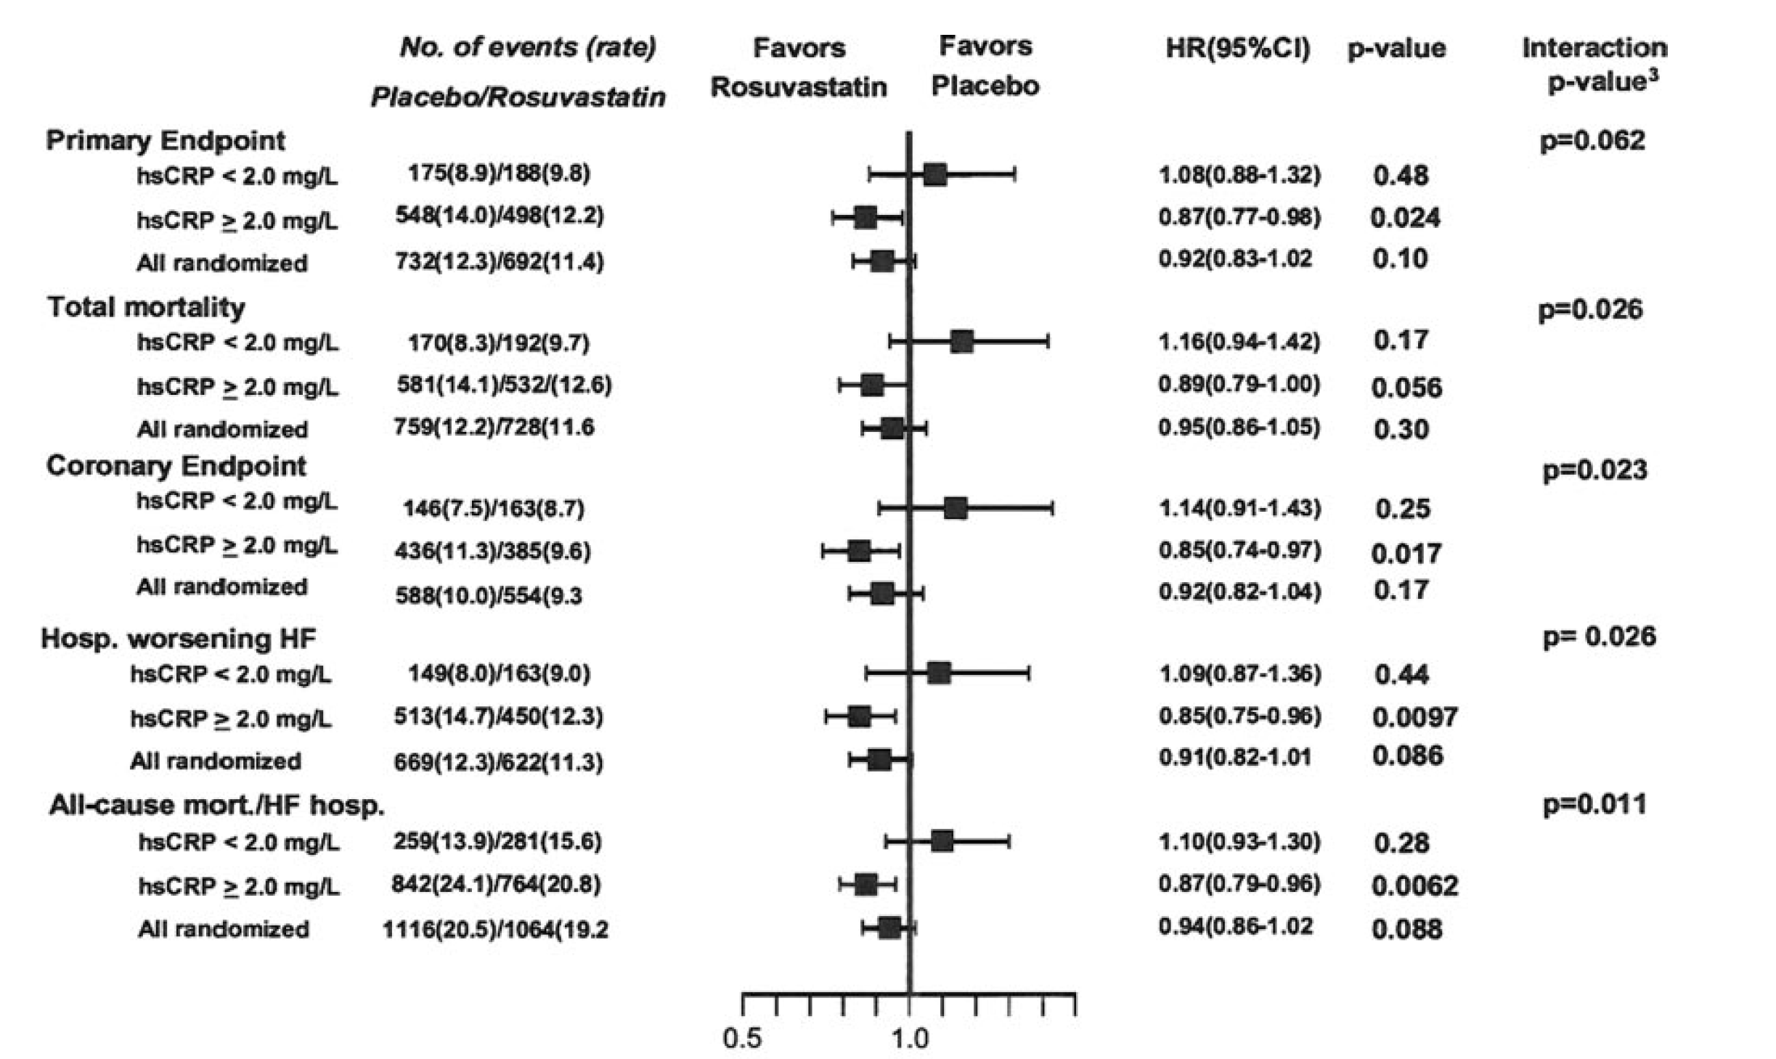
Clinical Relevance of hsCRP in the CORONA Trial
McMurray JJV, et al. Circulation 2009;2188-2196.

Slide 42
Questions for Discussion
What is the status of surrogate endpoints in the regulatory approval process?
If an endpoint is felt to be a “marker” of disease activity rather than a surrogate of disease activity (lies in the causal pathway), is lowering of the “marker” sufficient for approval?
Should lipid-lowering agents be approved for clinical use based upon surrogate endpoints like CRP, restenosis, QT interval etc.?
Do you see regulatory pathways built around “niche” markets in the future rather than around “all comers”? How do you address concerns such as expanded use of the drug in larger populations outside of the subgroup where it was evaluated?
How big will future trials be?

Slide 43
Questions for Discussion
If “hard” clinical endpoints are required, what are the most appropriate ones? What is the appropriate duration of follow-up? What RRR can we expect?
All Cause Death?
CV death?
Ischemic stroke, all stroke, hemg stroke
MI: Use of universal definition of MI to understand peri-procedural vs spontaneous MI vs demand etc.)? Size of MI?
Recurrent hospitalization vs recurrent hospitalization requiring revascularization
As part of an “adaptive” trial design, could phase II surrogate endpoint data be included in the dataset for a pivotal trial? Is there a role for Bayesian statistics and design in the future?

Slide 44
Questions for Discussion
What is the interplay between AHA / ACC guidelines and the regulatory approval process?
Must new drugs be studied on top of drugs that are already recommended in the ACC/ AHA guidelines?
If so, are we in a position where new drugs must add to existing ones rather than replace them?
Can trials utilize protocols that do not comply with the AHA / ACC guidelines?

Slide 45
Questions for Discussion
What is the proper role of the ARO and CRO?
Should they be competing or should they be complimentary?
How do they most effectively partner?

